Slide 1
CS 61C: Great Ideas in Computer Architecture Finite State Machines
Instructors:
Krste Asanovic & Vladimir Stojanovic
http://inst.eecs.berkeley.edu/~cs61c/sp15

Slide 2
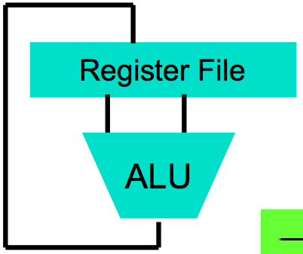
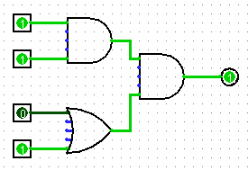
Levels of Representation/Interpretation
High Level Language Program (e.g., C)
temp = v[k];
v[k] = v[k+1];
v[k+1] = temp;
Compiler
Anything can be represented as a number, i.e., data or instructions
lw $t0, 0($2)
lw $t1, 4($2)
sw $t1, 0($2)
sw $t0, 4($2)
Assembly Language Program (e.g., MIPS)
Assembler
0000 1001 1100 0110 1010 1111 0101 1000
1010 1111 0101 1000 0000 1001 1100 0110
1100 0110 1010 1111 0101 1000 0000 1001
0101 1000 0000 1001 1100 0110 1010 1111
Machine Language Program (MIPS)
Machine Interpretation
Hardware Architecture Description (e.g., block diagrams)
Architecture Implementation
Logic Circuit Description (Circuit Schematic Diagrams)

Slide 3
Type of Circuits
Synchronous Digital Systems consist of two basic types of circuits:
Combinational Logic (CL) circuits
Output is a function of the inputs only, not the history of its execution
E.g., circuits to add A, B (ALUs)
Sequential Logic (SL)
Circuits that “remember” or store information
aka “State Elements”
E.g., memories and registers (Registers)

Slide 4
Uses for State Elements
Place to store values for later re-use:
Register files (like $1-$31 in MIPS)
Memory (caches and main memory)
Help control flow of information between combinational logic blocks
State elements hold up the movement of information at input to combinational logic blocks to allow for orderly passage

Slide 5
Accumulator Example
Why do we need to control the flow of information?
SUM
X_{i}
S
Want: S=0;
for (i=0;i<n;i++)
S = S + X_{i}
Assume:
Each X value is applied in succession, one per cycle
After n cycles the sum is present on S

Slide 6
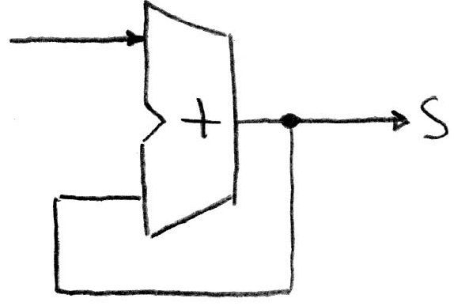
First Try: Does this work?
Feedback
No!
Reason #1: How to control the next iteration of the ‘for’ loop?
Reason #2: How do we say: ‘S=0’?

Slide 7
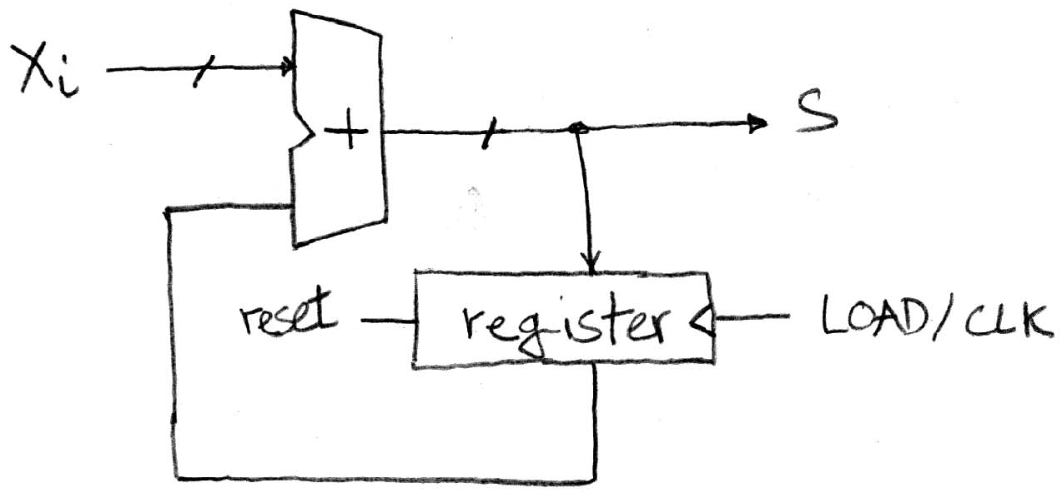
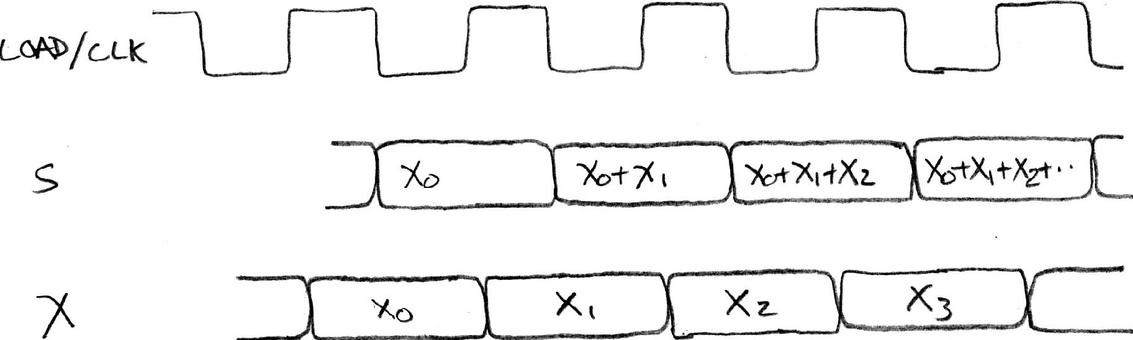
Second Try: How About This?
Register is used to hold up the transfer of data to adder
Square wave clock sets when things change
High (1)
Low (0)
Rough timing …
Rounded Rectangle per clock means could be 1 or 0
High (1)
Low (0)
Xi must be ready before clock edge due to adder delay
High (1)
Low (0)
Time

Slide 8
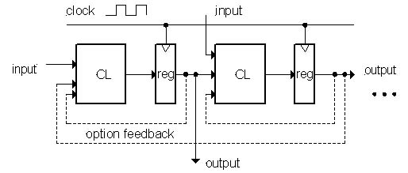
Model for Synchronous Systems
Collection of Combinational Logic blocks separated by registers
Feedback is optional
Clock signal(s) connects only to clock input of registers
Clock (CLK): steady square wave that synchronizes the system
Register: several bits of state that samples on rising edge of CLK (positive edge-triggered) or falling edge (negative edge-triggered)

Slide 9
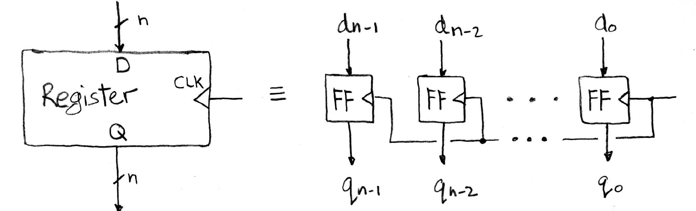
Register Internals
n instances of a “Flip-Flop”
Flip-flop name because the output flips and flops between 0 and 1
D is “data input”, Q is “data output”
Also called “D-type Flip-Flop”

Slide 10
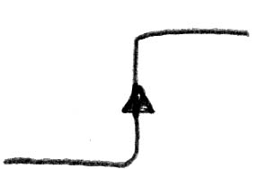
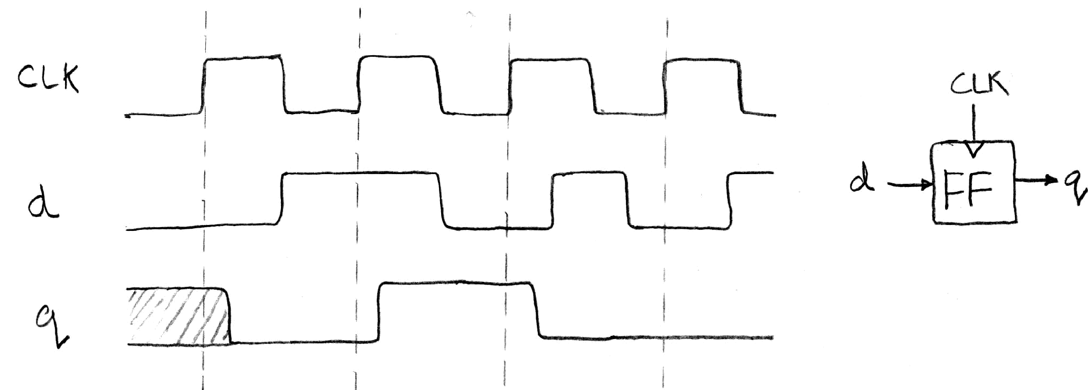
Flip-Flop Operation
Edge-triggered d-type flip-flop
This one is “positive edge-triggered”
“On the rising edge of the clock, the input d is sampled and transferred to the output. At all other times, the input d is ignored.”
Example waveforms:
Fall 2010 -- Lecture #23

Slide 11
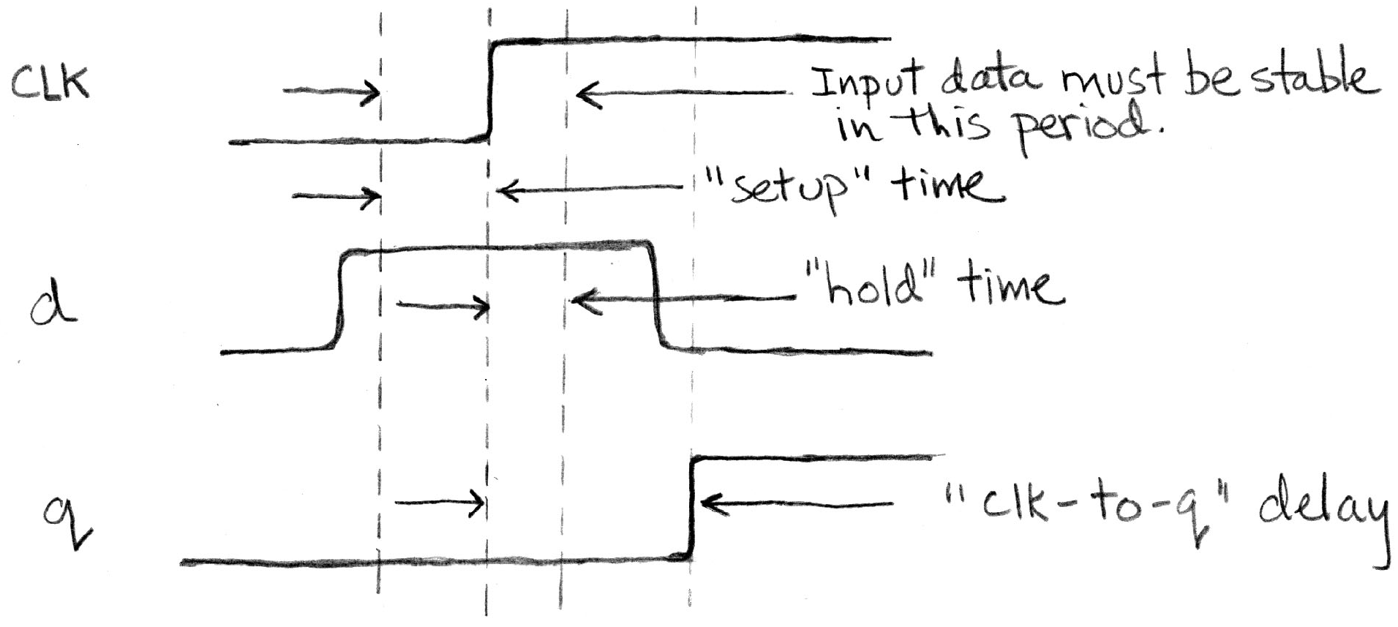
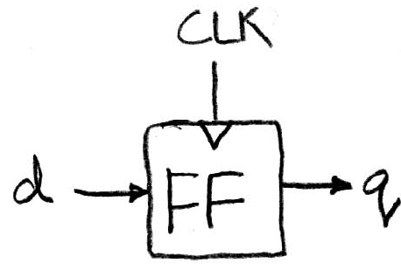
Flip-Flop Timing
Edge-triggered d-type flip-flop
This one is “positive edge-triggered”
“On the rising edge of the clock, the input d is sampled and transferred to the output. At all other times, the input d is ignored.”
Example waveforms (more detail):

Slide 12
Camera Analogy Timing Terms
Want to take a portrait – timing right before and after taking picture
Set up time – don’t move since about to take picture (open camera shutter)
Hold time – need to hold still after shutter opens until camera shutter closes
Time click to data – time from open shutter until can see image on output (viewscreen)

Slide 13
Hardware Timing Terms
Setup Time: when the input must be stable before the edge of the CLK
Hold Time: when the input must be stable after the edge of the CLK
“CLK-to-Q” Delay: how long it takes the output to change, measured from the edge of the CLK

Slide 14
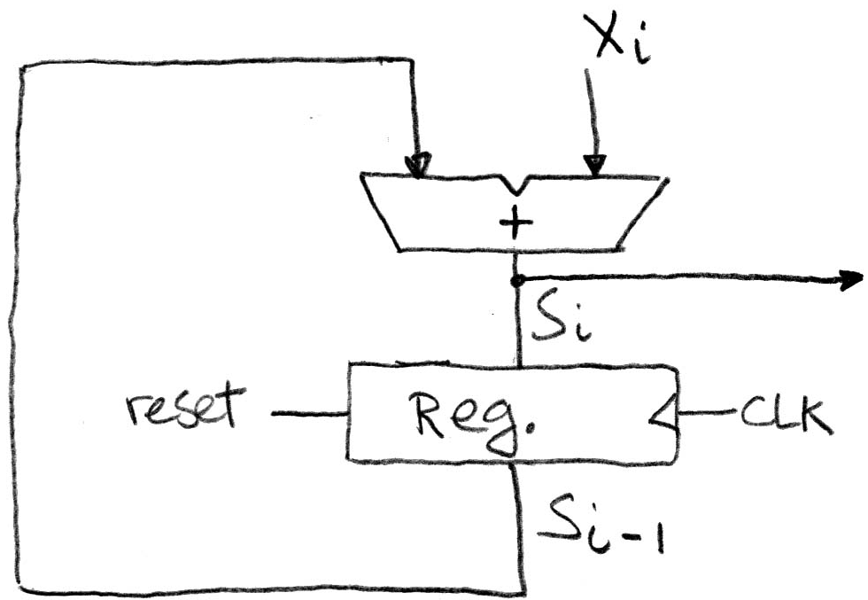
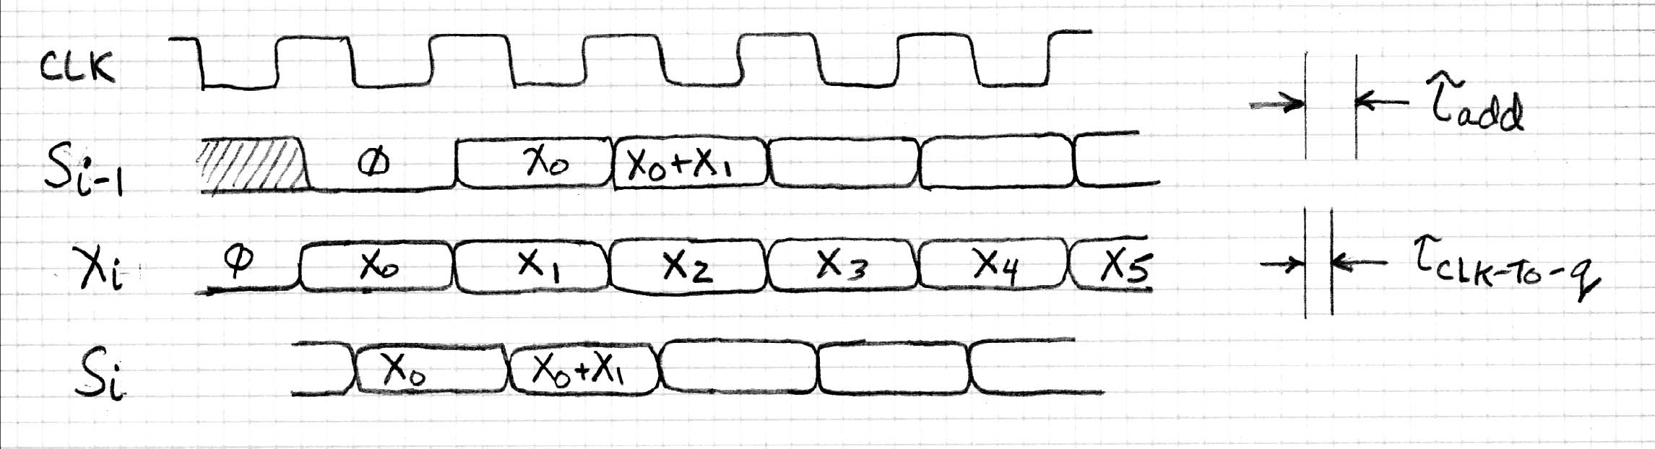
Accumulator Timing 1/2
Reset input to register is used to force it to all zeros (takes priority over D input).
S_{i-1} holds the result of the i^{th}-1 iteration.
Analyze circuit timing starting at the output of the register.

Slide 15
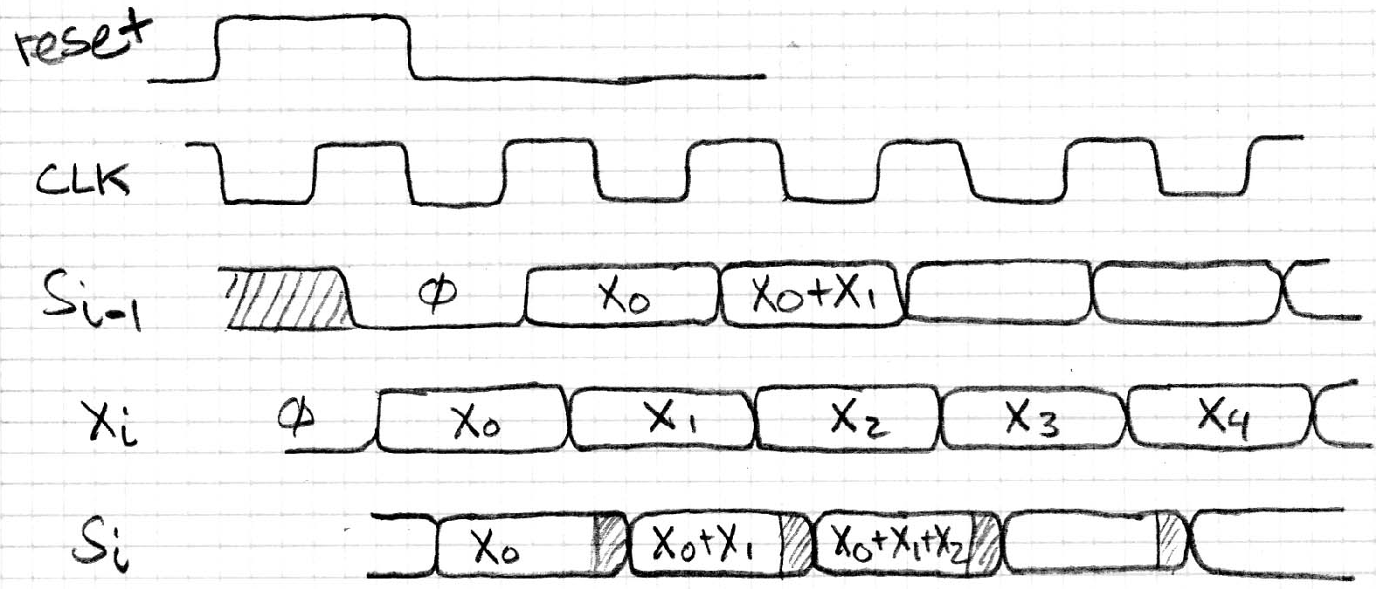
Accumulator Timing 2/2
reset signal shown.
Also, in practice X might not arrive to the adder at the same time as S_{i-1}
S_{i} temporarily is wrong, but register always captures correct value.
In good circuits, instability never happens around rising edge of clk.

Slide 16
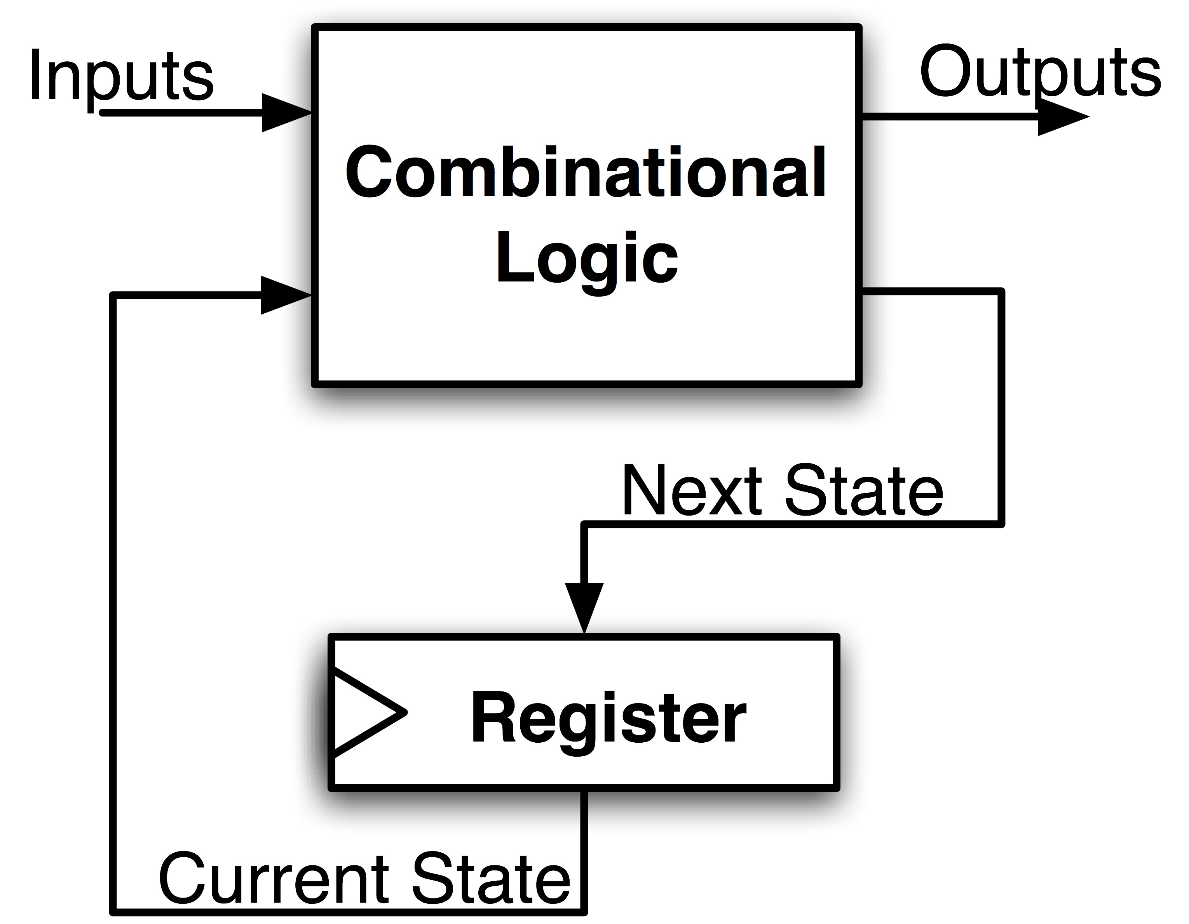
Maximum Clock Frequency
What is the maximum frequency of this circuit?
Hint:
Frequency = 1/Period
Max Delay = CLK-to-Q Delay + CL Delay + Setup Time

Slide 17
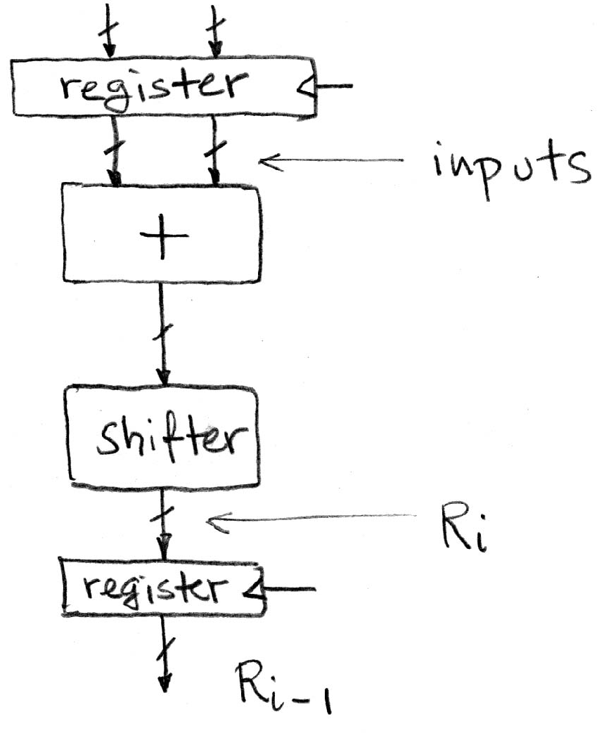
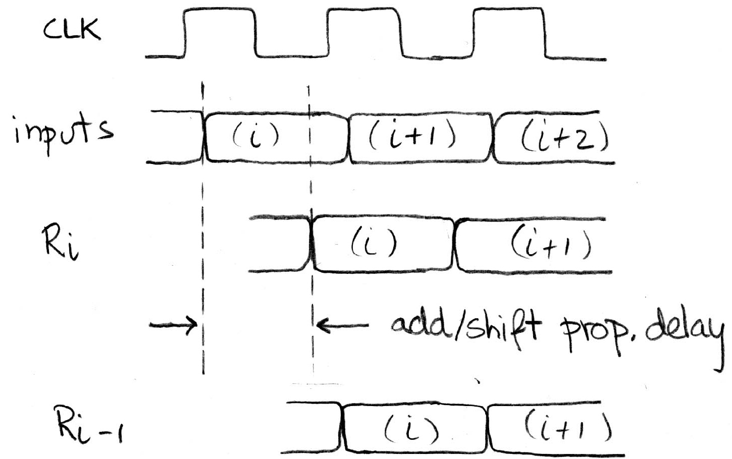
Critical Paths
Timing…
Note: delay of 1 clock cycle from input to output.
Clock period limited by propagation delay of adder/shifter.

Slide 18
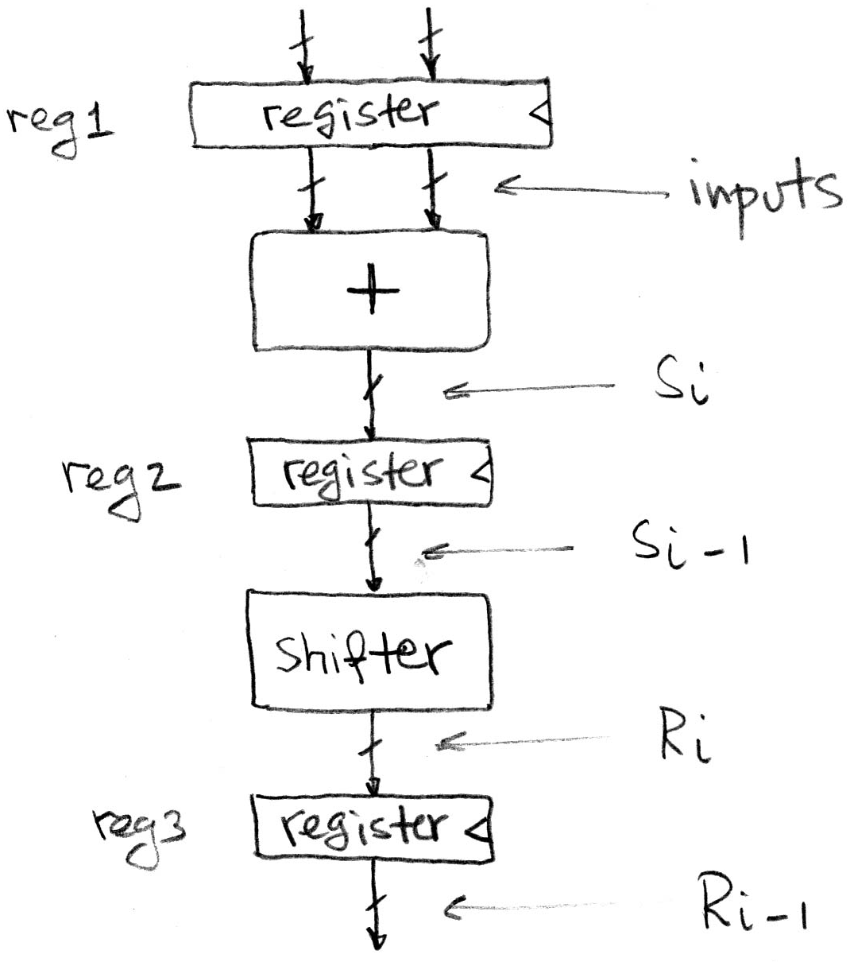
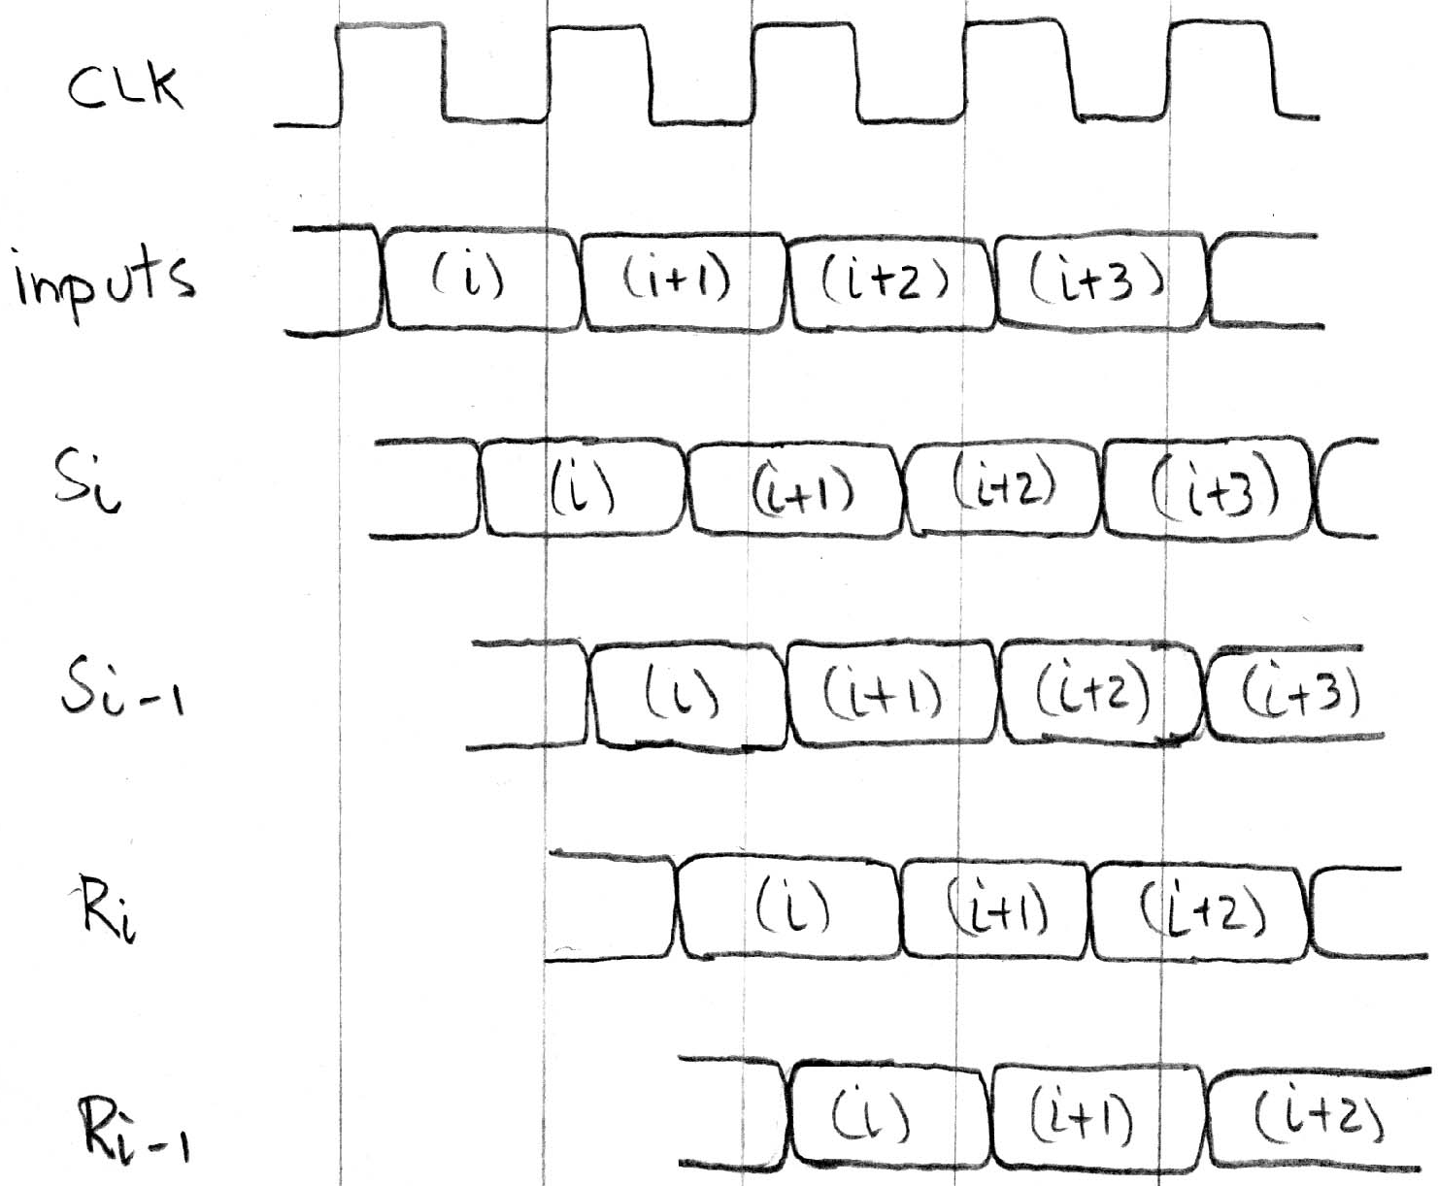
Pipelining to improve performance
Timing…
Insertion of register allows higher clock frequency.
More outputs per second (higher bandwidth)
But each individual result takes longer (greater latency)

Slide 19
Recap of Timing Terms
Clock (CLK) - steady square wave that synchronizes system
Setup Time - when the input must be stable before the rising edge of the CLK
Hold Time - when the input must be stable after the rising edge of the CLK
“CLK-to-Q” Delay - how long it takes the output to change, measured from the rising edge of the CLK
Flip-flop - one bit of state that samples every rising edge of the CLK (positive edge-triggered)
Register - several bits of state that samples on rising edge of CLK or on LOAD (positive edge-triggered)

Slide 20
Clickers/Peer Instruction
Clock->Q 1ns
Setup 1ns
Hold 1ns
AND delay 1ns
Clock
What is maximum clock frequency?
A: 5 GHz
B: 200 MHz
C: 500 MHz
D: 1/7 GHz
E: 1/6 GHz

Slide 21
Administrivia
Project 1-1 due 3/01
Midterm is next Thursday 2/26, in class
Covers up to and including the previous lecture
1 handwritten, double sided, 8.5”x11” cheat sheet
We’ll give you MIPS green sheet
Review Sessions:
TA: Monday 2/23, 7-9pm, 10 Evans
HKN: Saturday 2/21, 1-4pm, 100 Genetics Plant Biology

Slide 22
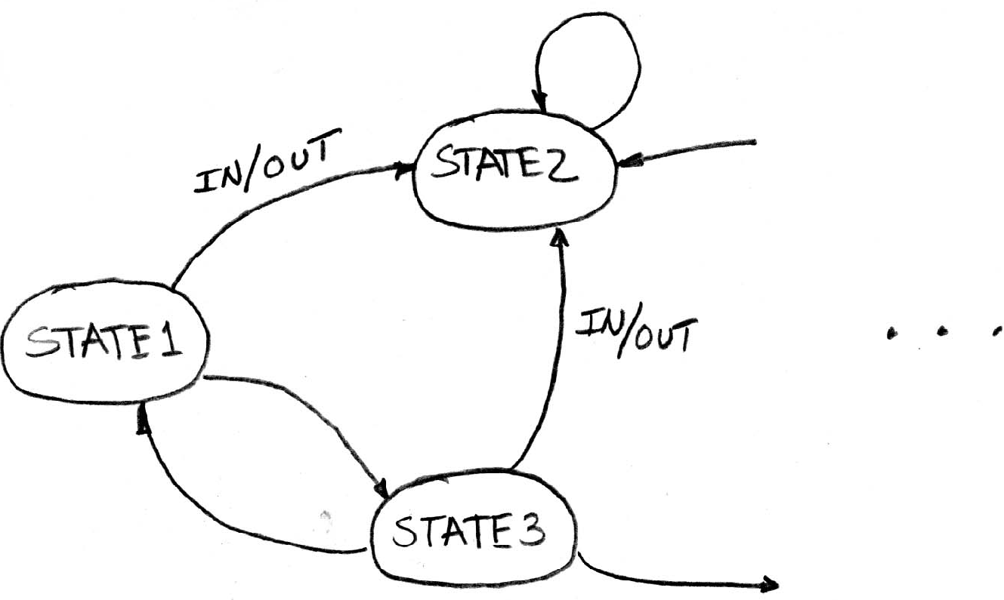
Finite State Machines (FSM) Intro
You have seen FSMs in other classes.
Same basic idea.
The function can be represented with a “state transition diagram”.
With combinational logic and registers, any FSM can be implemented in hardware.

Slide 23
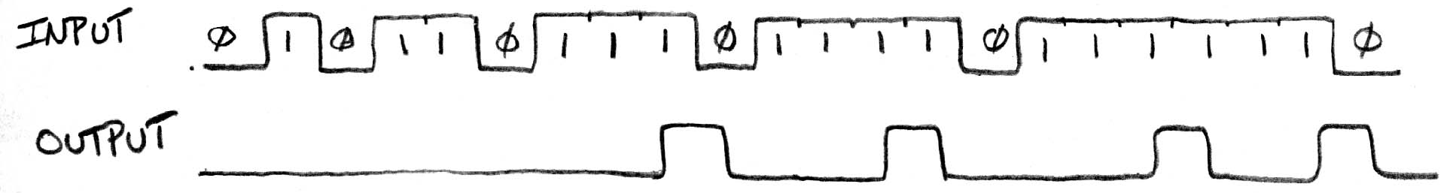
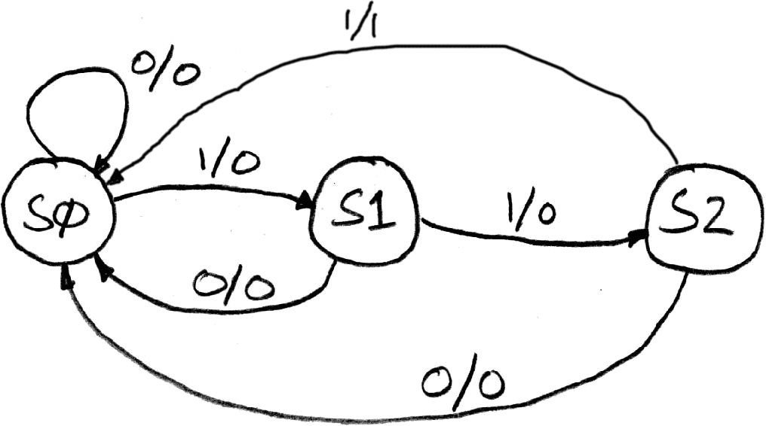
FSM Example: 3 ones…
FSM to detect the occurrence of 3 consecutive 1’s in the input.
Draw the FSM…
Assume state transitions are controlled by the clock:
on each clock cycle the machine checks the inputs and moves to a new state and produces a new output…

Slide 24
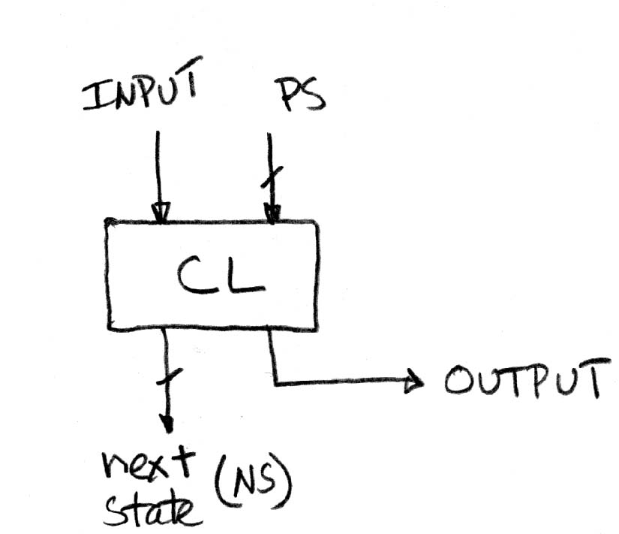
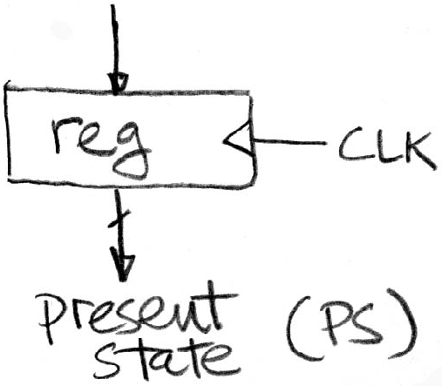
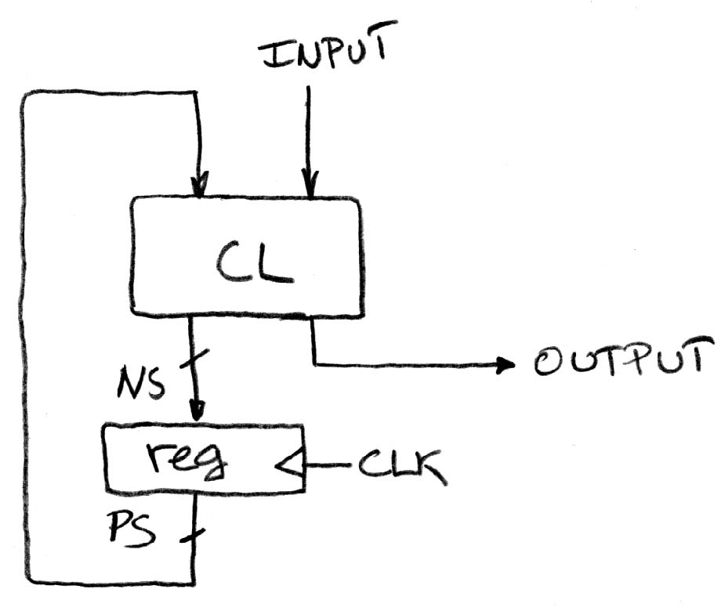
Hardware Implementation of FSM
… Therefore a register is needed to hold the a representation of which state the machine is in. Use a unique bit pattern for each state.
+
=
?
Combinational logic circuit is used to implement a function maps from present state and input to next state and output.

Slide 25
FSM Combinational Logic
Specify CL using a truth table.
Truth table…
PS
Input
NS
Output
00
0
00
0
00
1
01
0
01
0
00
0
01
1
10
0
10
0
00
0
10
1
00
1

Slide 26
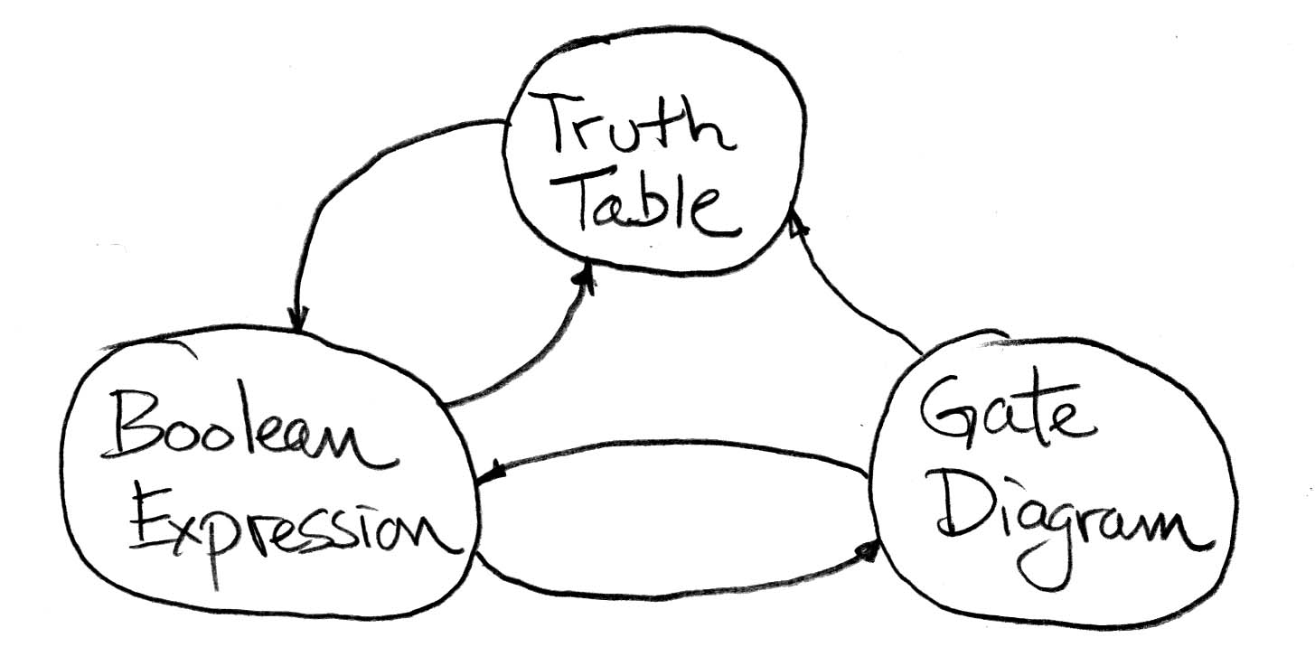
Moving between Representations
Use this table and techniques we learned last time to transform between alternative views of same logic function

Slide 27
Building Standard Functional Units
Data multiplexers
Arithmetic and Logic Unit
Adder/Subtractor

Slide 28
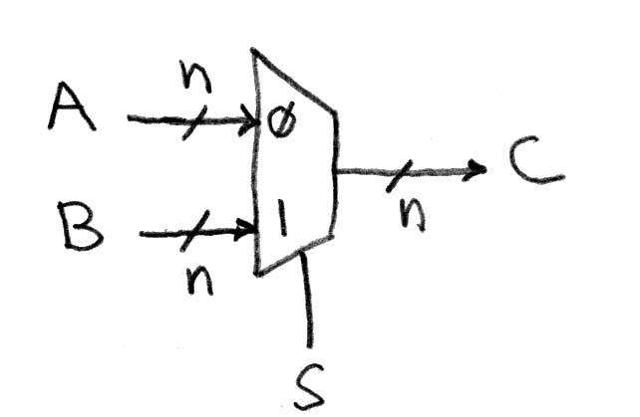
Data Multiplexer (“Mux”) (here 2-to-1, n-bit-wide)

Slide 29
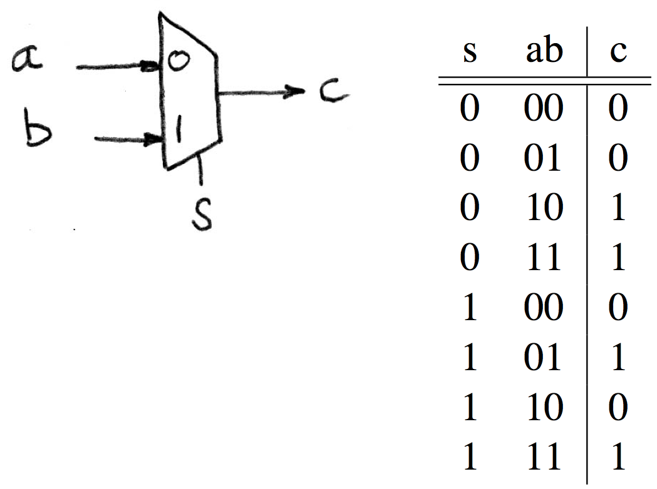
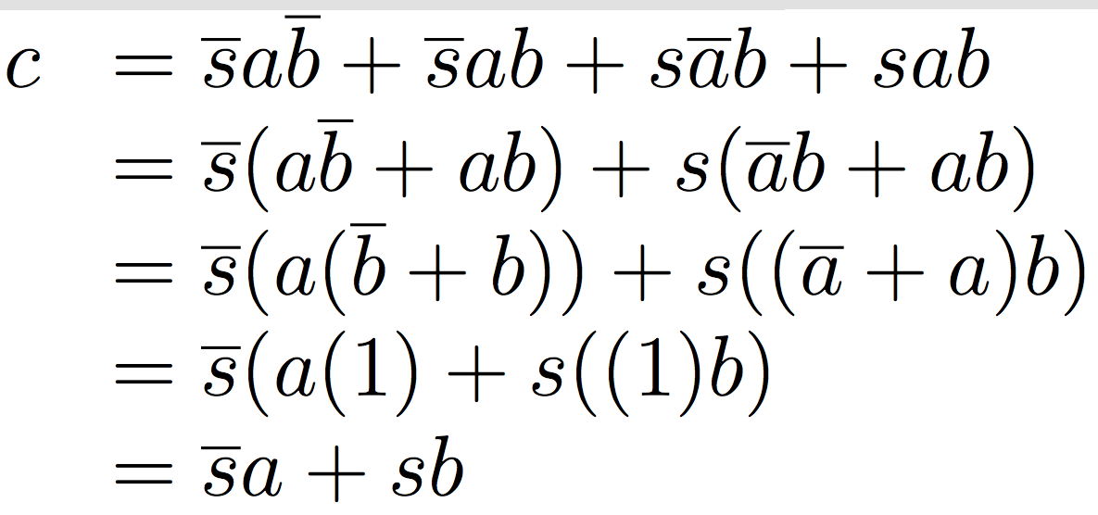
N instances of 1-bit-wide mux
How many rows in TT?

Slide 30
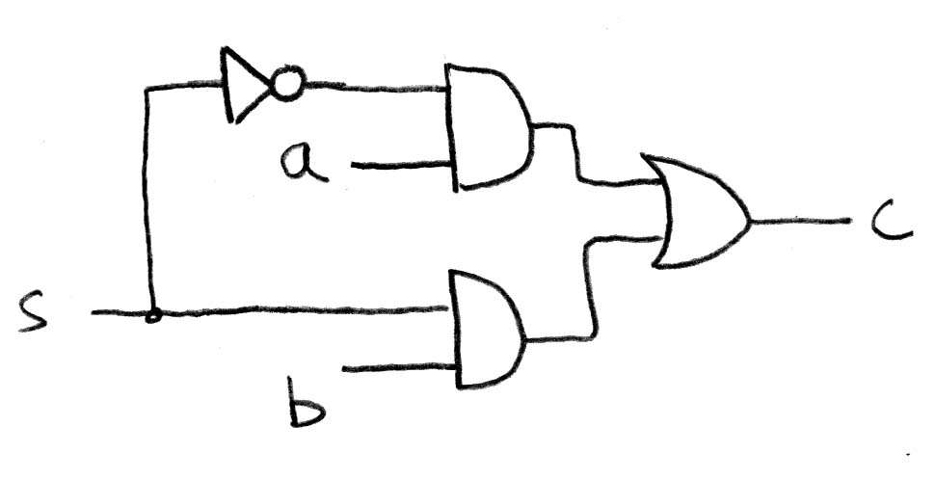
How do we build a 1-bit-wide mux?

Slide 31
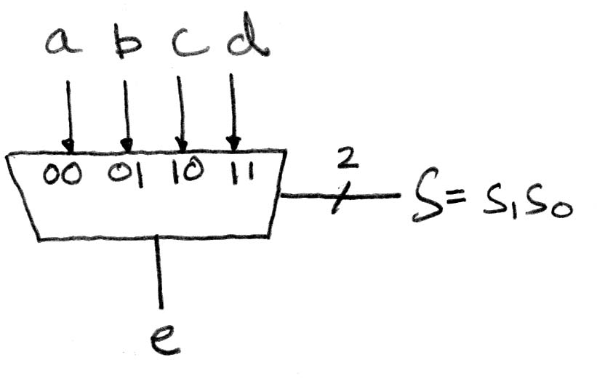
4-to-1 multiplexer?
How many rows in TT?

Slide 32
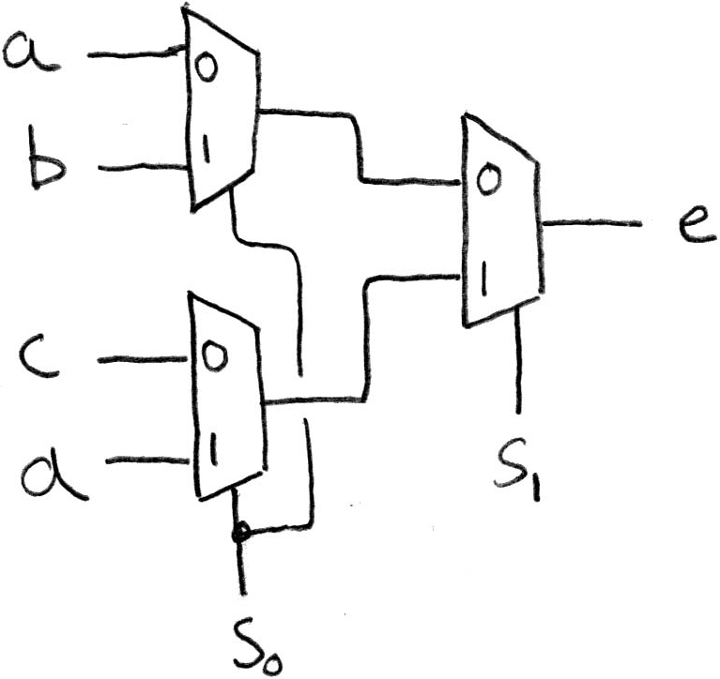
Another way to build 4-1 mux?
Hint: NCAA tourney!
Ans: Hierarchically!

Slide 33
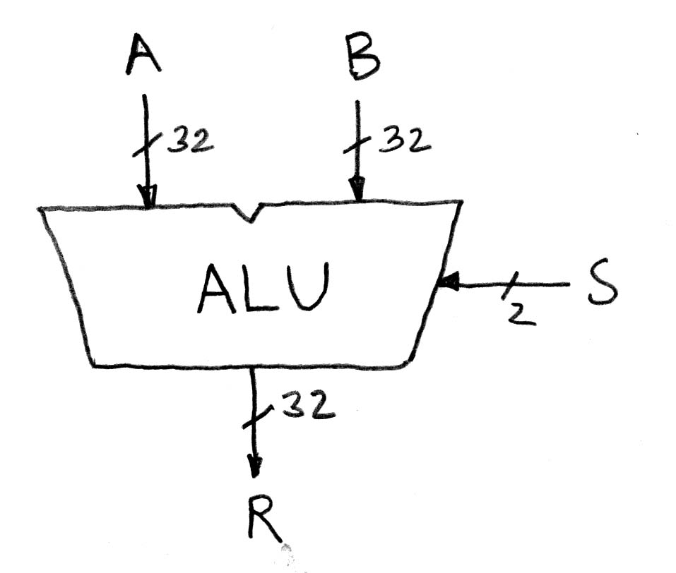
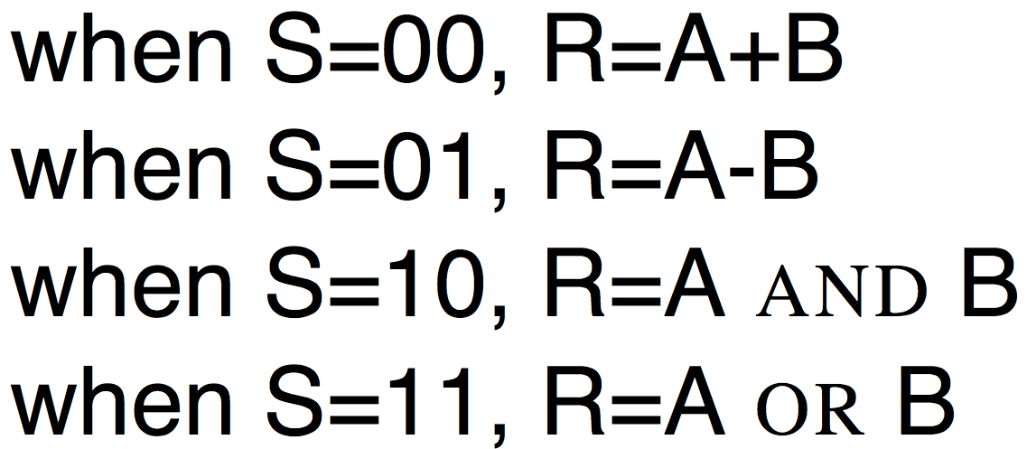
Arithmetic and Logic Unit
Most processors contain a special logic block called the “Arithmetic and Logic Unit” (ALU)
We’ll show you an easy one that does ADD, SUB, bitwise AND, bitwise OR

Slide 34
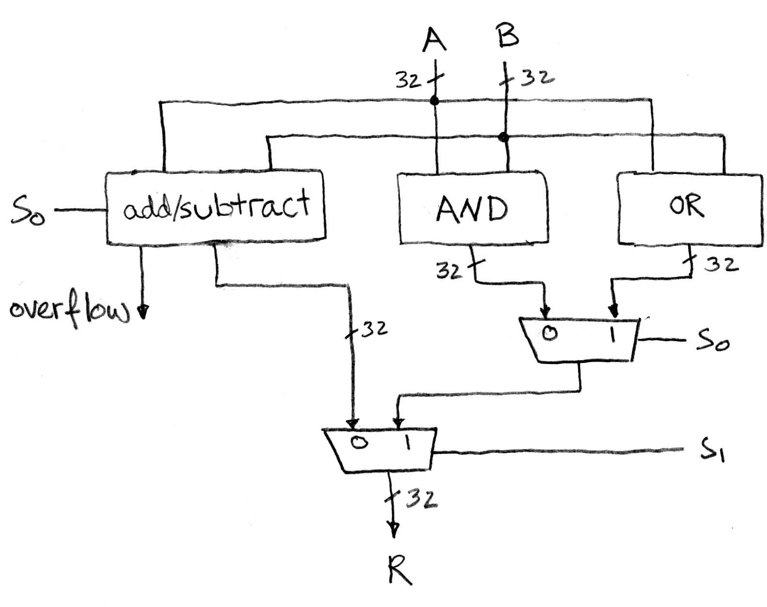
Our simple ALU

Slide 35

In the News: Microsoft, Google beat Humans at Image Recognition (EE Times)
On ImageNet benchmark image database, systems from Microsoft and Google performed better than humans at recognizing images
Both companies used deep artificial neural networks to train on image database

Slide 36
How to design Adder/Subtractor?
Truth-table, then determine canonical form, then minimize and implement as we’ve seen before
Look at breaking the problem down into smaller pieces that we can cascade or hierarchically layer

Slide 37
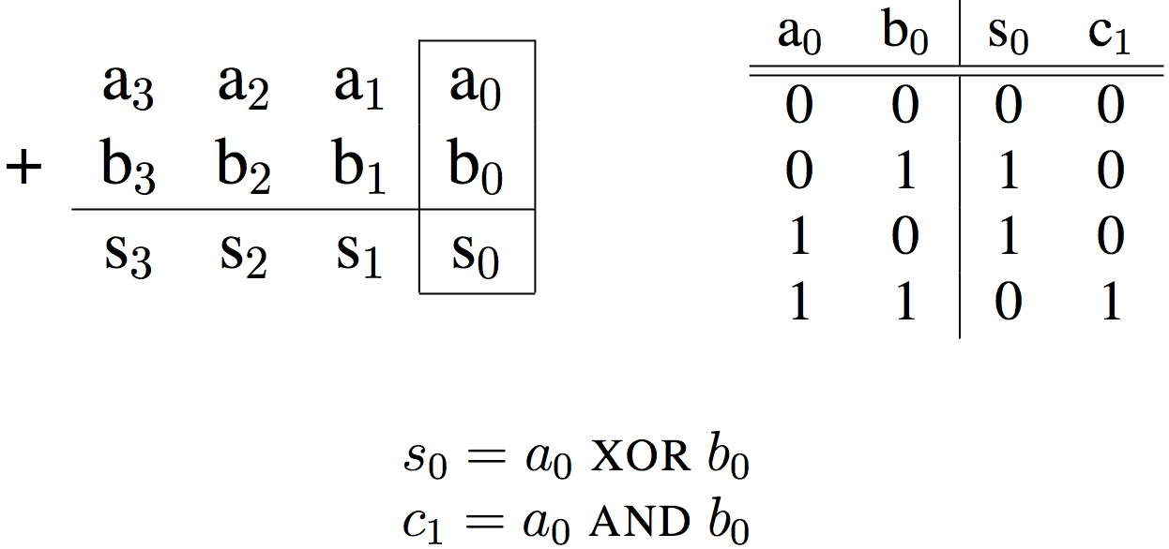
Adder/Subtractor – One-bit adder LSB…

Slide 38
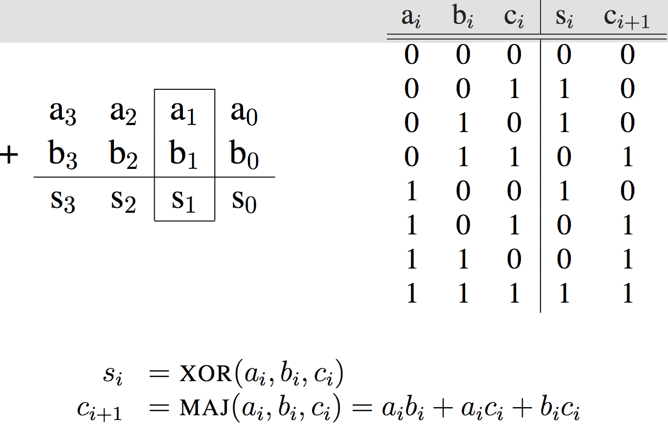
Adder/Subtractor – One-bit adder (1/2)…

Slide 39
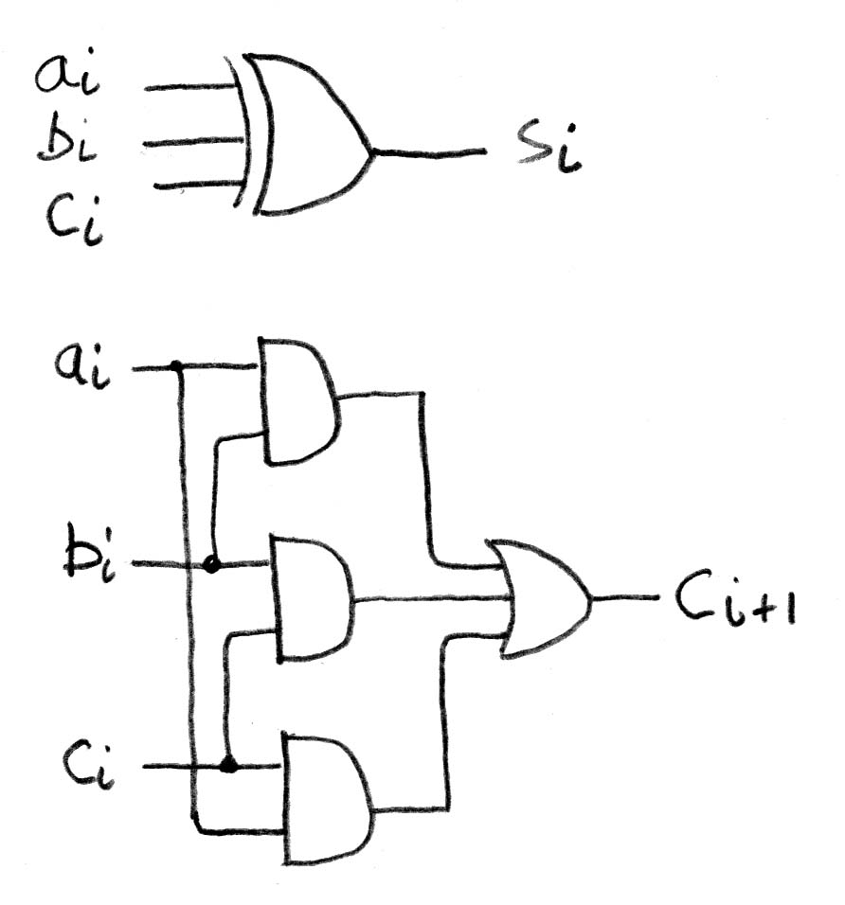
Adder/Subtractor – One-bit adder (2/2)

Slide 40
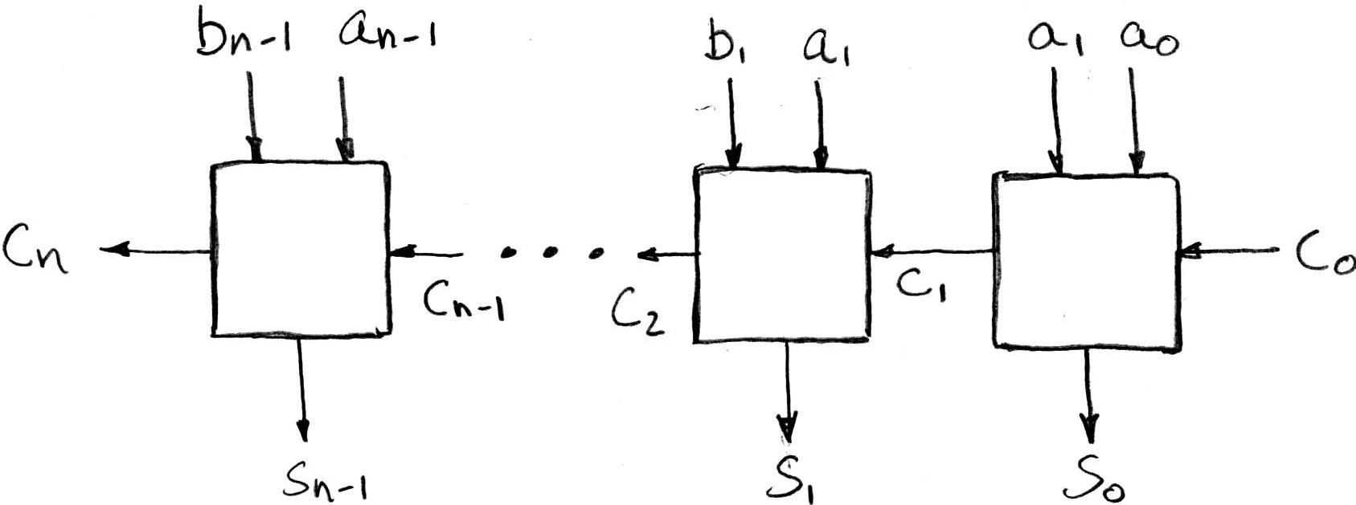
N 1-bit adders ⇒ 1 N-bit adder
b₀
+
+
+
What about overflow?
Overflow = c_{n}?

Slide 41
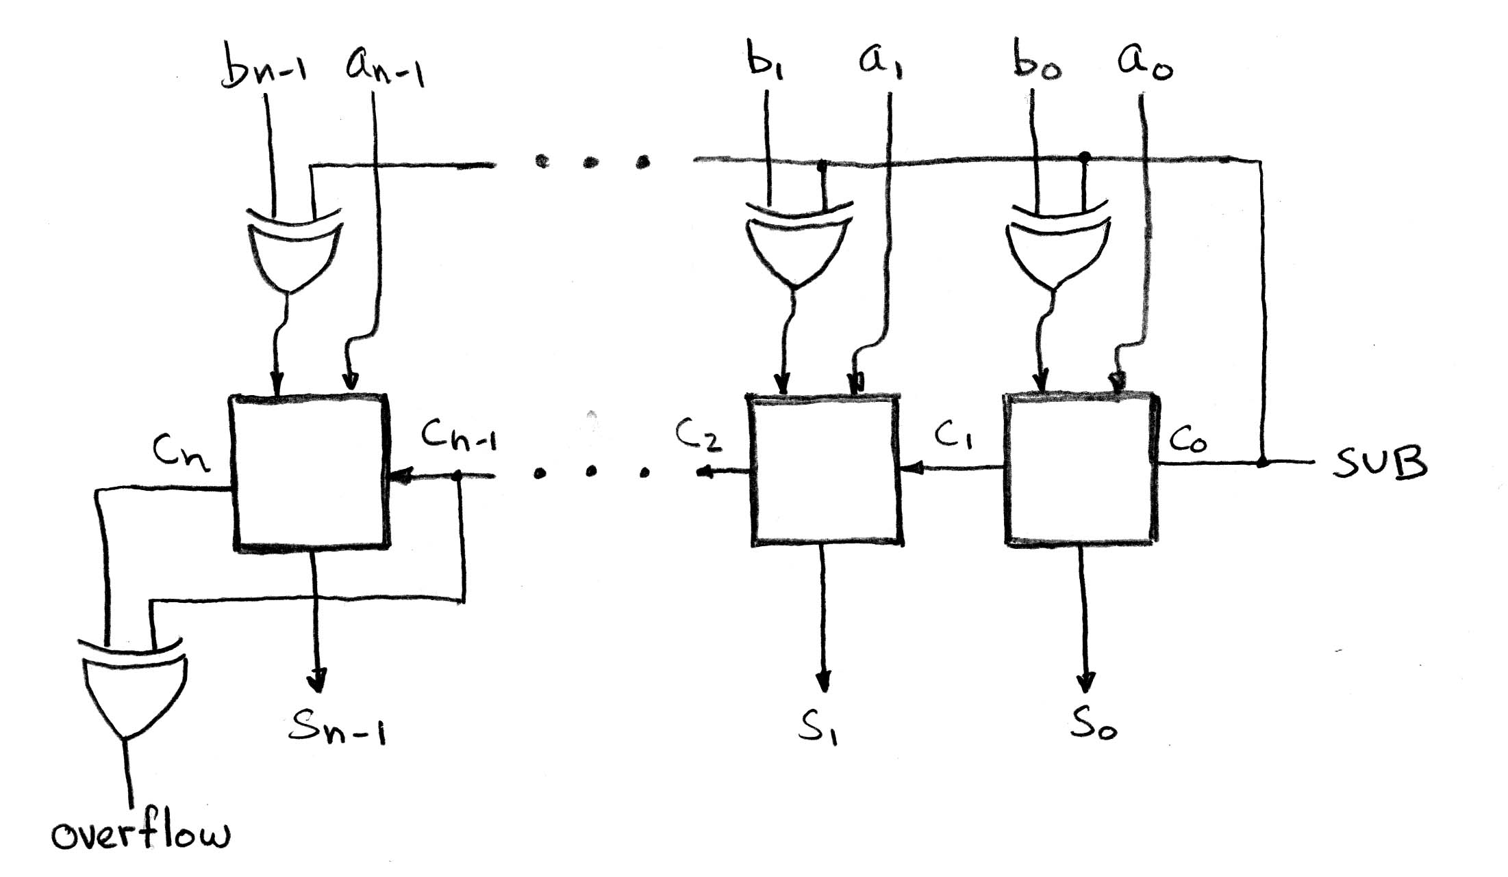
Extremely Clever Subtractor
+
+
+
x | y | XOR(x,y)
0 | 0 | 0
0 | 1 | 1
1 | 0 | 1
1 | 1 | 0
XOR serves as conditional inverter!

Slide 42
In Conclusion
Finite State Machines have clocked state elements plus combinational logic to describe transition between states
Standard combinational functional unit blocks built hierarchically from subcomponents

